Slide 1
MySQL Installation on Windows

Slide 2
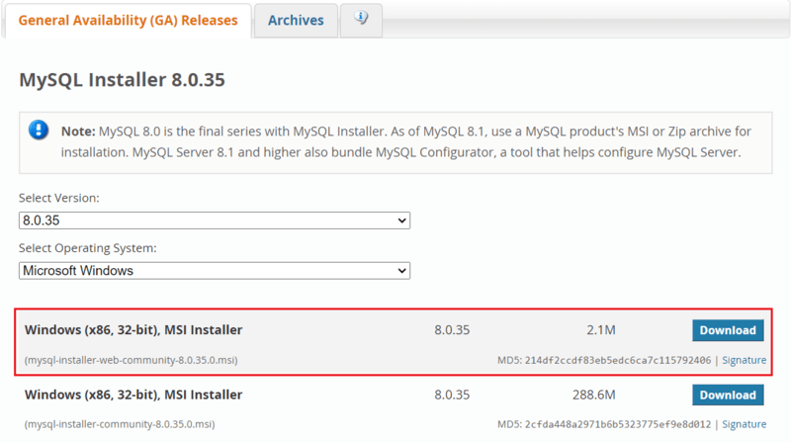
How to Install MySQL on Windows?
Now, Let’s break down MySQL software downloading steps for better understanding.
Step 1: Visit the Official MySQL Website
Open your preferred web browser and navigate to the official MySQL website. Now, Simple click on first download button.

Slide 3
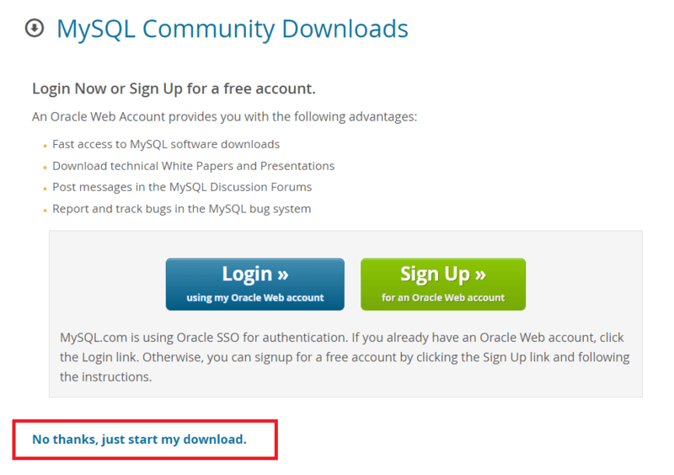
Step 2: Go to the Downloads Section
On the MySQL homepage, Click on the ”No thanks, just start my download” link to proceed MySQL downloading.

Slide 4
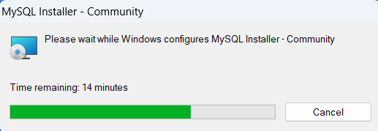
Step 3: Run the Installer
Once the installer is downloaded, run it to start the MySQL installation.

Slide 5
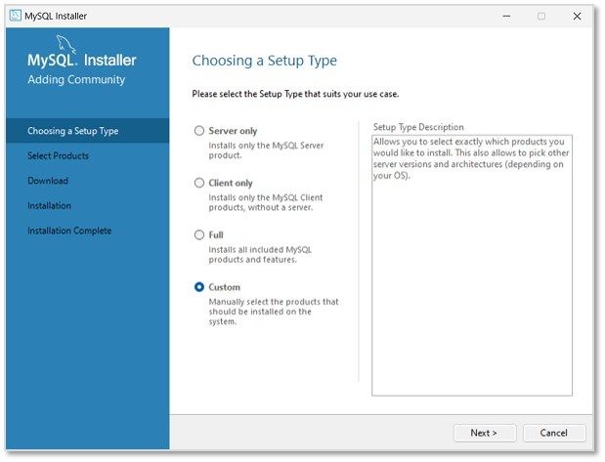
Step 4: Choose Setup Type
Now, we can see the installer community window, asking to choose a Setup type for our MySQL products. Choose Custom and click Next to decide what products we want to actually install.

Slide 6
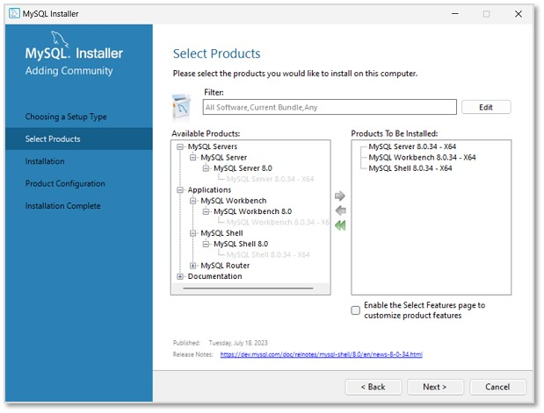
Step 5: Select Products
In the next step, select MySQL Server, MySQL Workbench, MySQL Shell (all latest versions) to be installed. We can also choose more products available as per necessity. Click Next.

Slide 7
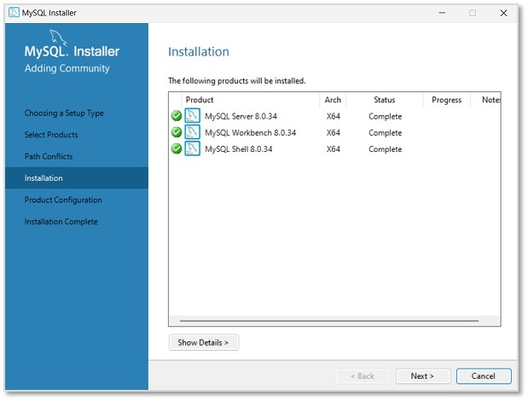
Step 6: MySQL Installing
The installation process will now begin. However, path conflicts might arise if there exists a path directory with the same name. After the installation is done, click Next.

Slide 8
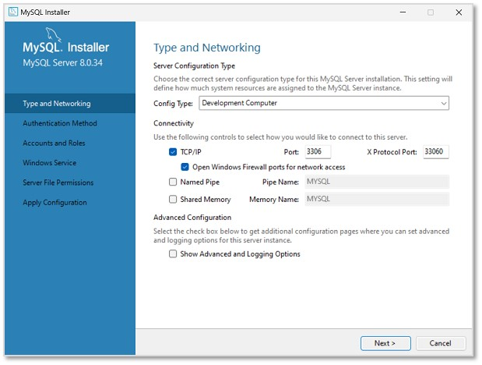
Step 7: Type and Networking
In this step, we will be asked to set Type and Networking of MySQL. Unless there is any particular change we want to make, it is recommended to keep the settings as they are, and click Next.

Slide 9
Step 8: Authentication method
Then, we need to set the Authentication method to access MySQL root user. So, choose the strong password encryption method (as it is recommended) and click Next.

Slide 10
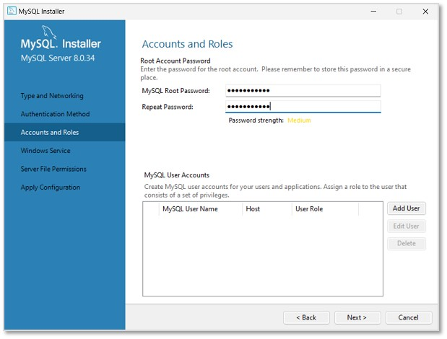
Step 9: Creating Password
Set a password for the root account. This password must always be used to log into the root account in every session. After setting password, click Next.

Slide 11
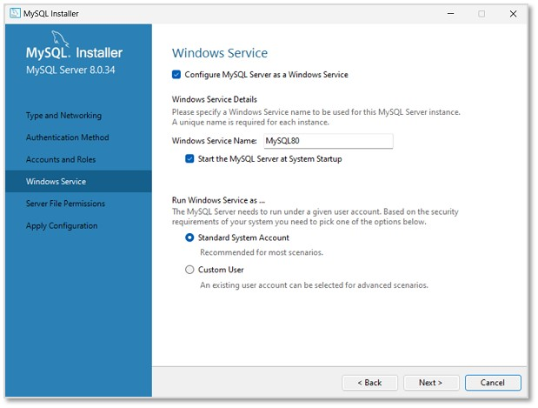
Step 10: Windows Service
In this step, MySQL Server Instance will be configured as a Windows Service. The default name will be set as "MySQL80", which can be changed if needed. Click Next.

Slide 12
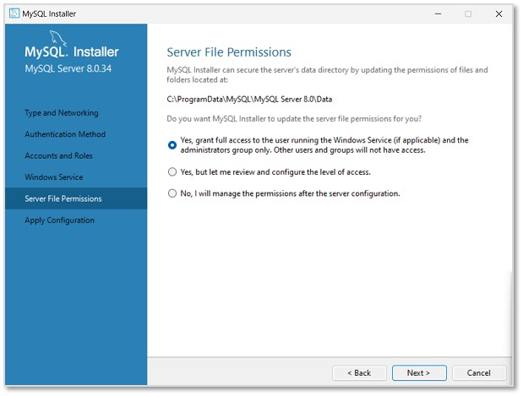
Step 11: Server file Permissions
Now, set the file permissions as required and click Next.

Slide 13
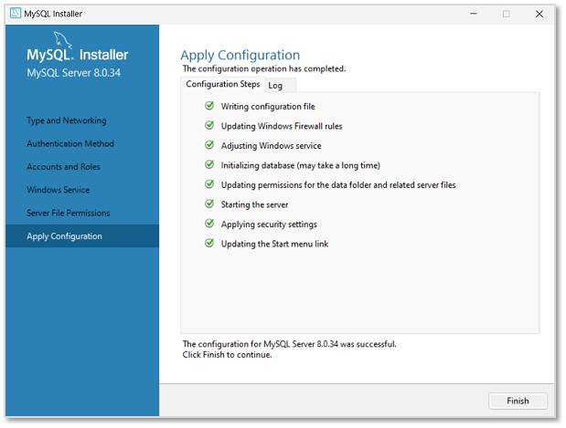
Step 12: Apply Configuration
As shown in the image below, the specified configuration steps will be applied on clicking Execute.

Slide 14
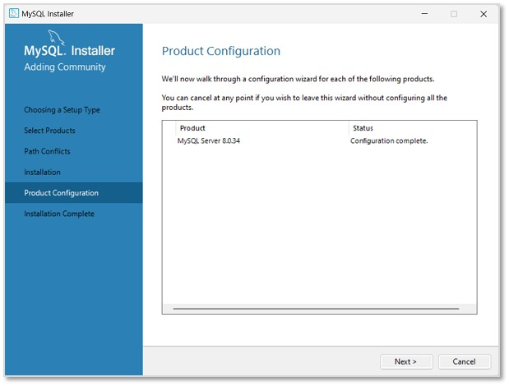
Step 13: Product Configuration
Once it is completed, click Finish. The next window will display the products on which the configuration is applied. Click Next to finish the installation.

Slide 15
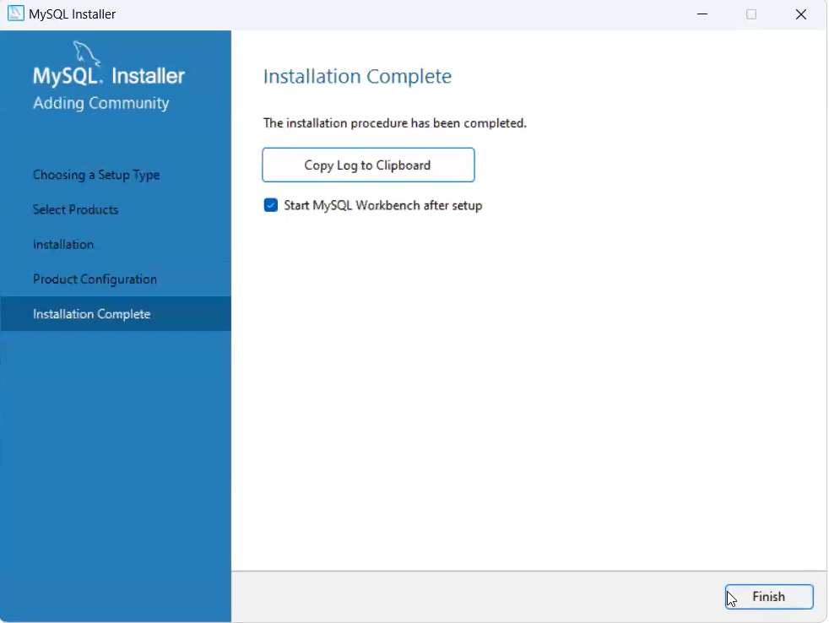
Step 14: Installation Complete
The installation is now complete. Uncheck the options asking to start MySQL Workbench and Shell after setup, so that they will not run after setup. Click Finish.

Slide 16
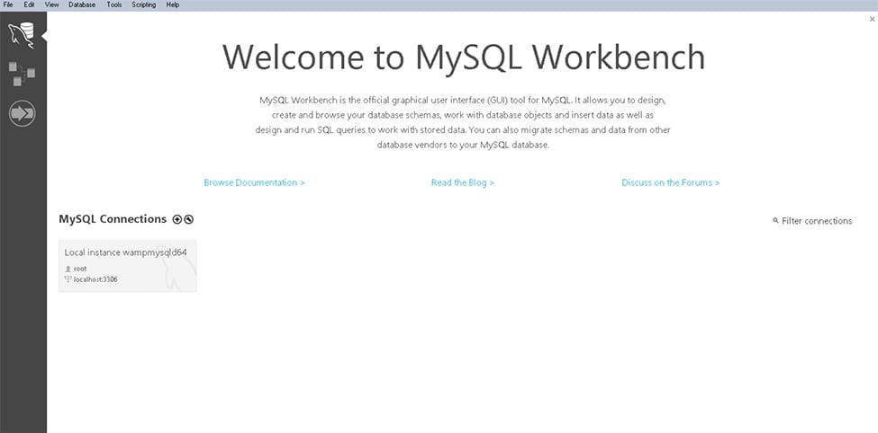
Step 15: Verify Installation
To ensure a successful installation of MySQL, open the MySQL Command Line Client or MySQL Workbench, both available in your Start Menu. Log in using the root user credentials you set during installation.
MySQL Workbench Is Ready To Use

Slide 17
THANK
YOU!

